Slide 1
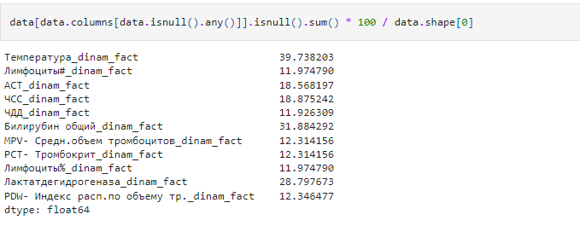
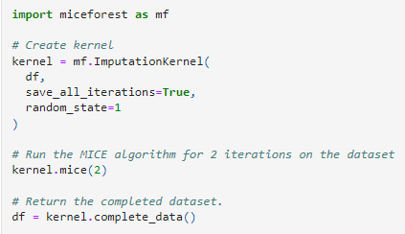

First, replace null values with MICE algorithm

Slide 2
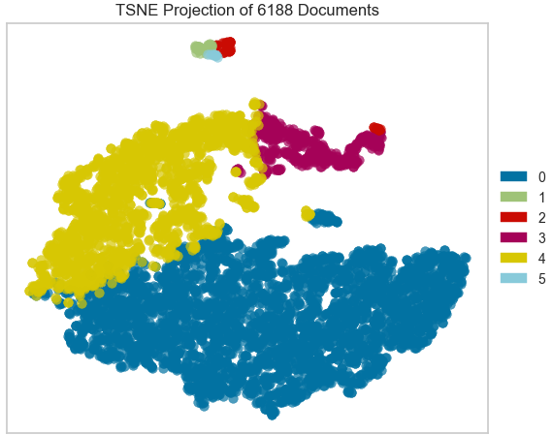
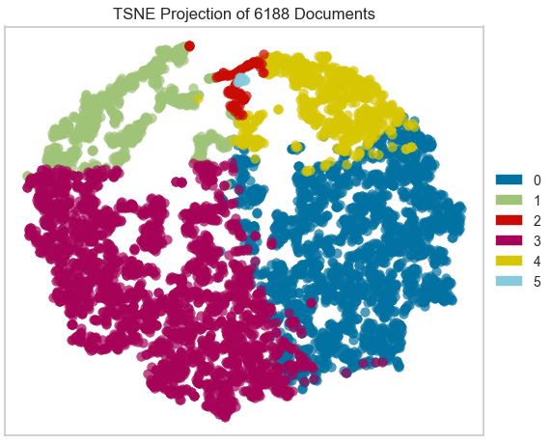
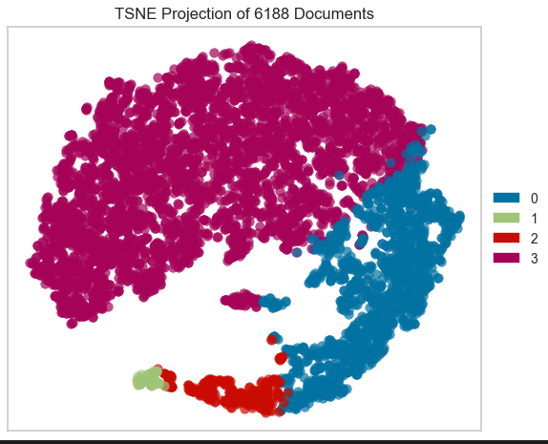
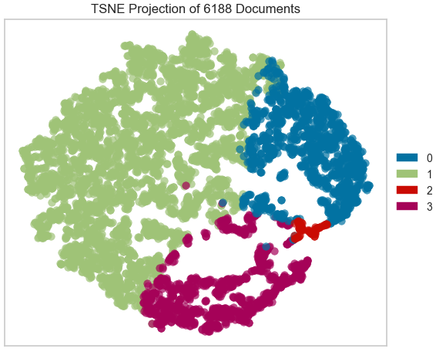
Kmeans with cosine similarity
Kmeans
N clusters = 6, Silhoutte = 0.471
N clusters = 6, Silhoutte = 0.134
N clusters = 4, Silhoutte = 0.514
N clusters = 4, Silhoutte = 0.188

